Slide 1
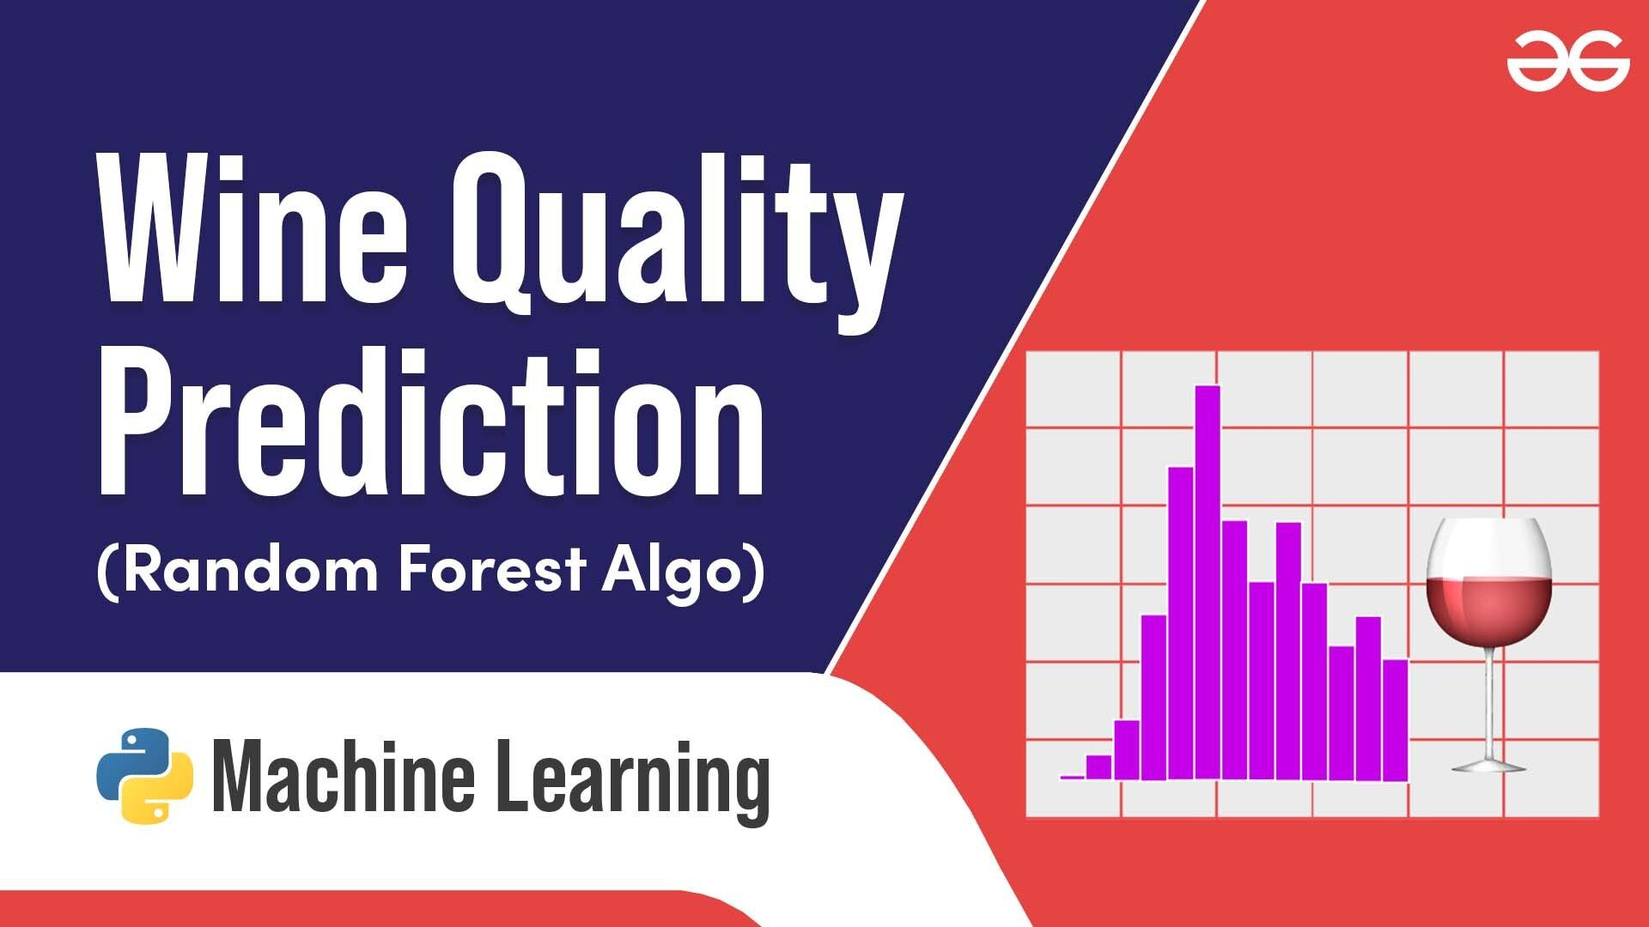
Predicting Wine Quality Using Machine Learning: An Exploratory Study and Model Comparison
Name : Hemlatha Kaur Saran
George David Asirvatharaj
Raminder Singh

Slide 2

Introduction
Problem Statement & Objective
Predict wine quality using Machine Learning using two modelling approaches:
Regression - Predict exact quality score
Classification - Predict if a wine is good or bad
Compare different algorithms to identify the best-performing model
Importance of Wine Quality Prediction
Helps producers improve product quality through data-driven decisions
Assists consumers to make informed choices.
Dataset Overview (UCI)
4898 white wine samples, 11 chemical features and quality scores (0-10).
Target Variable
Quality score reflecting expert ratings, mostly between 3 and 8.
Notes:
Today, I will describe our project on how machine learning is used to predict how well white wine will be evaluated. Predicting wine quality benefits both those who make it and those who drink or sell it. Our model was trained on data with nearly 5,000 samples, including quality scores and 11 chemical measurements. We wanted to see whether we could estimate the quality of wine as a value or identify it as either good or bad using data analysis methods called regression and classification.

Slide 3
Team Contribution
George David Asirvatharaj
Dataset selection, Data cleaning and preparation
Performing Exploratory Data Aanalysis (EDA)
Summary Statistics and Distribution Plots
Hemlatha Kaur Saran
Correlation Matrix
Box Plots (Feature vs Quality relationship)
Regression Models
Linear Regression, Random Forest Regressor, XGBoost
Raminder Singh
Classification Model performance - accuracy , precision, recall , F1-score
Confusion matrix
Feature importance from Random Forest and Shap summary plot
Notes:
Today, I will describe our project on how machine learning is used to predict how well white wine will be evaluated. Predicting wine quality benefits both those who make it and those who drink or sell it. Our model was trained on data with nearly 5,000 samples, including quality scores and 11 chemical measurements. We wanted to see whether we could estimate the quality of wine as a value or identify it as either good or bad using data analysis methods called regression and classification.

Slide 4
Data Cleaning and Preparation
Data Quality
No missing values - a complete dataset
Simplified preprocessing
Feature Overview
All 11 features are numeric, representing chemical properties
Suitable for direct input into machine learning models
Feature Scaling
Standardization applied to features
Important for algorithms like SVM and k-NN that are sensitive to feature scales
Target Transformation (for Classification)
Created a binary classification label
Good wine: quality ≥ 7, Not good: quality < 7
Notes:
Today, I will describe our project on how machine learning is used to predict how well white wine will be evaluated. Predicting wine quality benefits both those who make it and those who drink or sell it. Our model was trained on data with nearly 5,000 samples, including quality scores and 11 chemical measurements. We wanted to see whether we could estimate the quality of wine as a value or identify it as either good or bad using data analysis methods called regression and classification.

Slide 5
Summary Statistics
Feature | Mean | Std Dev | Min | 25% | 50% | 75% | Max
Fixed Acidity | 6.85 | 0.84 | 3.80 | 6.30 | 6.80 | 7.30 | 14.20
Volatile Acidity | 0.28 | 0.10 | 0.08 | 0.21 | 0.26 | 0.32 | 1.10
Citric Acid | 0.33 | 0.12 | 0.00 | 0.27 | 0.32 | 0.39 | 1.66
Residual Sugar | 6.39 | 5.07 | 0.60 | 1.70 | 5.20 | 9.90 | 65.80
Chlorides | 0.05 | 0.02 | 0.01 | 0.04 | 0.04 | 0.05 | 0.35
Free Sulfur Dioxide | 35.31 | 17.01 | 2.00 | 23.00 | 34.00 | 46.00 | 289.00
Total Sulfur Dioxide | 138.37 | 42.50 | 9.00 | 108.00 | 134.00 | 167.00 | 440.00
Density | 0.99 | 0.003 | 0.99 | 0.99 | 0.99 | 0.99 | 1.04
pH | 3.19 | 0.15 | 2.90 | 3.09 | 3.18 | 3.28 | 3.82
Sulphates | 0.49 | 0.15 | 0.41 | 0.41 | 0.47 | 0.55 | 1.08
Alcohol | 10.51 | 1.07 | 8.40 | 9.50 | 10.40 | 11.40 | 14.20
Quality | 5.88 | 0.87 | 3.00 | 5.00 | 6.00 | 6.00 | 9.00
Notes:
Today, I will describe our project on how machine learning is used to predict how well white wine will be evaluated. Predicting wine quality benefits both those who make it and those who drink or sell it. Our model was trained on data with nearly 5,000 samples, including quality scores and 11 chemical measurements. We wanted to see whether we could estimate the quality of wine as a value or identify it as either good or bad using data analysis methods called regression and classification.

Slide 6
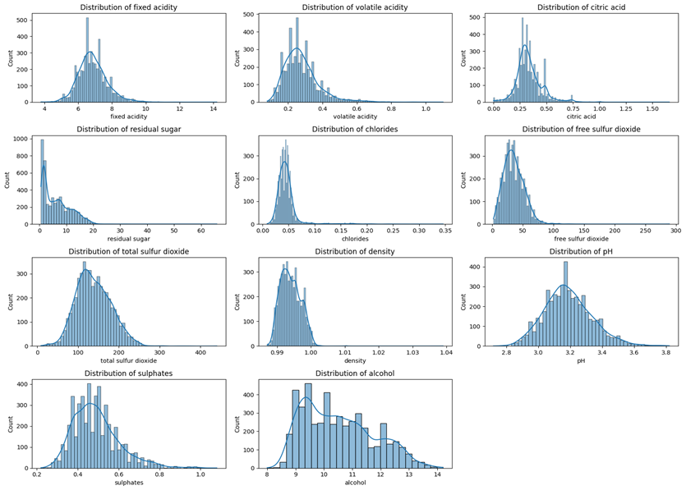
Distribution plots for key features
Feature Distributions – Most chemical properties showed right-skewed distributions.
Residual Sugar – Highly positively skewed with few samples having extremely high sugar.
pH and Density – Approximately normal distribution, indicating consistency.
Alcohol Content – Displays a wide spread, higher alcohol levels linked to better quality wines, hence the key factor in determining wine quality.
Notes:
The analysis pointed out some valuable patterns. Most acidity and sugar content values were moderate, with just a few numbers from the upper end. Residual sugar results showed that a few wines were delightful. The distributions of pH and density looked normal, suggesting these features were more reliable in most cases. Wine content differed significantly due to its significant impact on the quality of the wine people tasted.

Slide 7
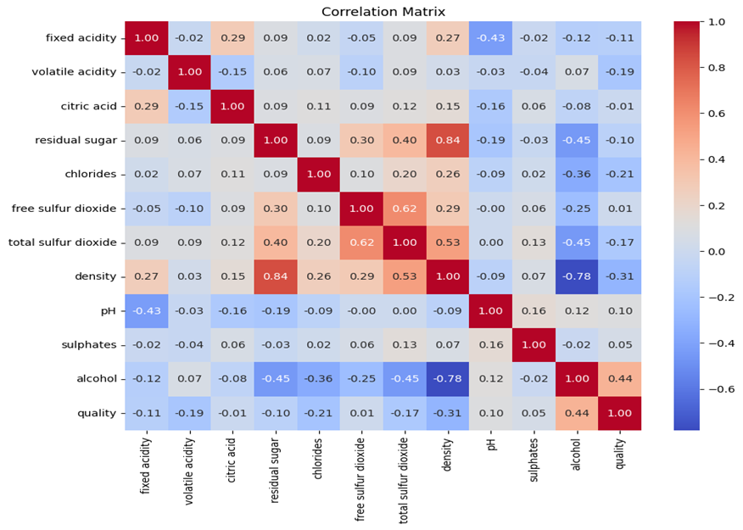
Correlation matrix and key insights
Correlation Matrix – The correlation matrix demonstrates the relationship between different wine properties and quality
A strong and positive relationship (0.44) exists between higher alcohol content and increased perceived quality
Negative Correlations – Density and volatile acidity negatively correlated with quality.
Weak Correlations – Most features showed low correlation, suggesting complex interactions.
Insight – Quality depends on a combination of factors, not just one variable.
Notes:
According to the analysis, alcohol was the most important factor linked to better wine quality. At the same time, a greater density was usually linked to lower levels of volatile acidity. Most other characteristics were only weakly related, suggesting that several different factors affect the quality of wine. Since the problem is complex, any effective model should show how different features interact nonlinearly.

Slide 8
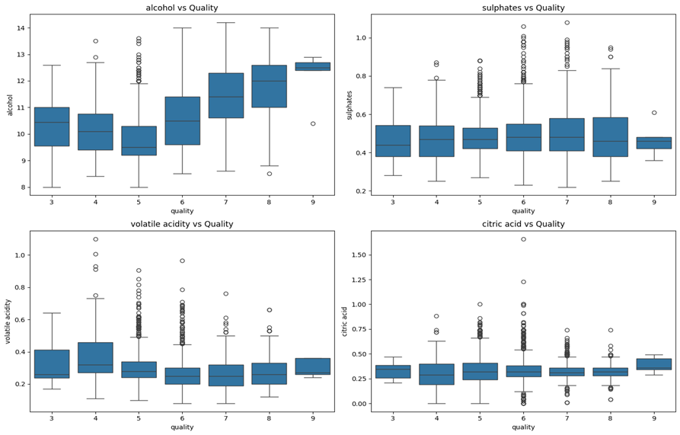
Boxplots comparing quality with important features
The boxplots reveal that multiple chemical measurements are linked to the quality of the wine.
Alcohol and Quality – Higher alcohol content is associated with better quality.
Sulphates Trend – There is a slight increase in sulphates with higher quality.
Volatile Acidity – Decreases as quality improves, negative impact.
Citric Acid – Less clear relationship, minor influence on quality.
Notes:
Boxplots of each feature versus quality scores clearly showed some patterns. Greater quality wines often have more alcohol inside, which is very important. The quality of wine usually brings about a higher number of sulphates, though it is a less noticeable trend. A noticeable pungent smell from volatile acidity increases in lower-quality wines, so it decreases in better wines. The results indicate that citric acid contributes less to the difference in wine quality.

Slide 9


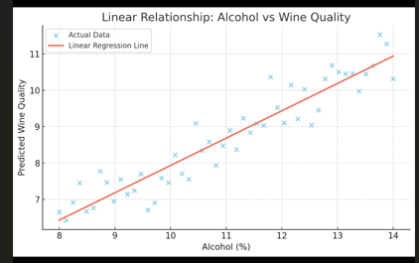

Model Selection - Regression
The project involved investigating and solving problems of the types of regression and classification. In regression, we tried to estimate the wine quality, while in classification, we marked wines as Good or Bad if their score was higher or lower than 7
We need linear regression to quickly understand relationships and make simple predictions.
It’s one of the fastest models to train and doesn’t require heavy computation

Slide 10
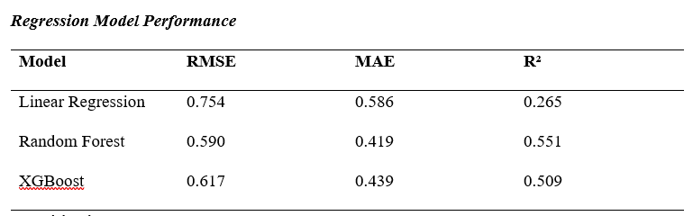
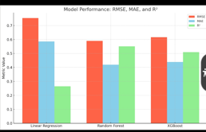
Model Selection – Regression
Models Tested – Linear Regression, Random Forest, and XGBoost.
Linear Regression – Baseline with simple assumptions, limited complexity.
Random Forest – Handles nonlinearities and feature interactions well.
XGBoost – Powerful gradient boosting, strong performance on structured data.
Notes:
I tested three regression models to see how they would predict continuous wine quality scores. I started with Linear Regression, believing the relationship was linear and straightforward. The tree-based Random Forest can find out how various features interact with each other. Another similar model, called XGBoost, performs very well on data organized in tables. I examined the models by checking RMSE, MAE, and R-squared to measure their performance.

Slide 11
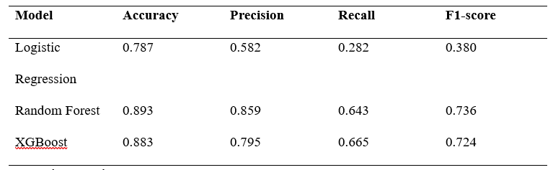
Model Selection – Classification
Models Used – Logistic Regression, Random Forest, XGBoost.
Logistic Regression – A simple linear classifier struggles with class imbalance.
Random Forest – Strong accuracy, balances precision, and recall well.
XGBoost – Slightly better recall and good overall classification performance.
Notes:
I chose to use Logistic Regression, Random Forest, and XGBoost to classify wines as good or bad. However, it has a basic design. Logistic regression struggles with imbalanced groups, hence resulting in poor recall. Overall, Random Forest achieved both high accuracy and a good level of both precision and recall. In the following place, XGBoost helped by identifying a larger collection of excellent wines. It was found that the performance of ensemble models outperformed others on complex data used for classification.

Slide 12
Model Evaluation and Comparison
Regression Results – Random Forest had the lowest RMSE and highest R².
Classification Results – Random Forest achieved the highest accuracy and F1 score.
Interpretability – Tree-based models offer feature-importance insights.
Model Trade-offs – Balancing accuracy, recall, and complexity is key.
Notes:
Random Forest was the best-performing model in both regression and classification. For regression, the errors in predictions were among the lowest, and the model accounted for half of the changes in quality. Classification showed the most excellent accuracy and F1-score, proving that the precision and recall were evenly good. According to experts, tree-based models give insights into why a prediction is made by highlighting its top features. It is important to balance the accuracy, ease of understanding, and computational demands of the model when making a decision.

Slide 13
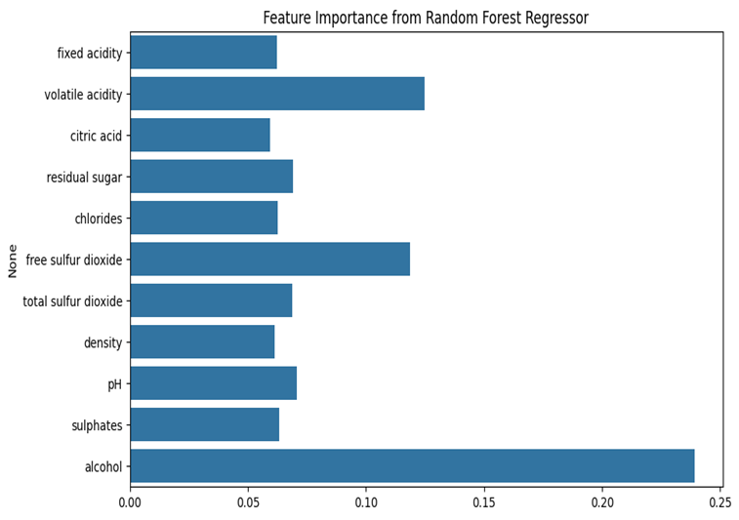
Feature Importance
Top Features – Alcohol, free sulfur dioxide, and volatile acidity are the most influential.
Importance Reflects Chemistry – Aligns with known wine quality factors.
SHAP Analysis – Reveals how high or low feature values impact predictions.
Complex Interactions – The model captures nuanced effects beyond simple correlations.
Notes:
The analysis of features found that the alcohol level in wine has the most significant impact on its quality, closely followed by free sulfur dioxide and volatile acidity. The results are consistent with what is understood about chemistry and winemaking. SHAP analysis also showed how the values of each feature can affect the predictions by highlighting fine relationships. It considers how features interact, giving us a real idea of what affects wine quality.

Slide 14
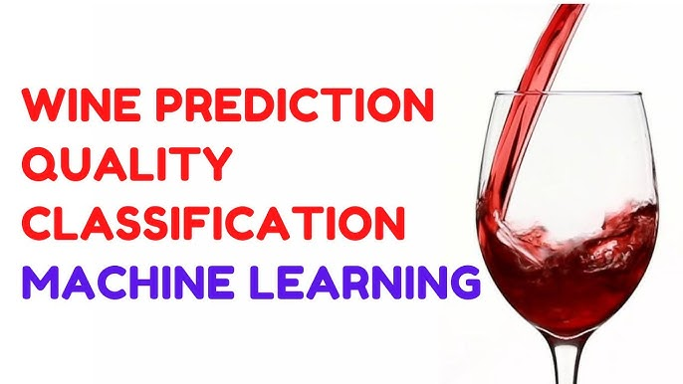
Conclusion and Future Work
Summary – Machine learning models effectively predict wine quality using chemical features.
Best Model – Random Forest showed strong performance in both tasks.
Practical Implications – Models assist producers and consumers in quality assessment.
Future Directions – Explore deeper models, hyperparameter tuning, and additional data sources.
Notes:
The results show that it is possible to accurately predict the quality of white wine by analyzing its chemical features. Among all the models, Random Forest showed excellent accuracy and is easy to understand. Wineries use these methods to monitor their wines while satisfying the taste buds of wine lovers everywhere. Further work may improve the models, fine-tune the parameters, and take advantage of sensory information or experts' knowledge to increase the accuracy of future predictions. There is hope that machine learning can enhance how wine quality is assessed.

